Slide 1
MINI PROJECT ON TIME SERIES ANALYSIS TO PREDICT THE SALES OF THE FURNITURE STORES
Manas Ghodke
DSFT 8

Slide 2
Introduction
Every business owner’s objective is to estimate the future trends – in terms of sales, profits, gains etc.
To do this analysis, the owner first has to segregate the data by category and analyze each entity separately.
For each entity, a forecast can be estimated based on the past sales of that entity.
The idea behind this is to find out the popularity of a certain product and how its sales can impact the business.
Every product category is unique and cater to different customer base.
So the analysis cannot be generalized that one trend is applicable to all products.
A thorough insight into the past performance will reveal a lot of components that will enable the business to identify the trends.

Slide 3
Business Objective
Build a forecast model to predict the furniture sales of a certain store

Slide 4
STEPS CARRIED OUT TO BUILD TIME SERIES MODEL
1. Visualize the time series
2. Stationarize the series
3. Plot ACF/PACF charts and find optimal parameters
4. Build the ARIMA model
5. Make the predictions

Slide 5
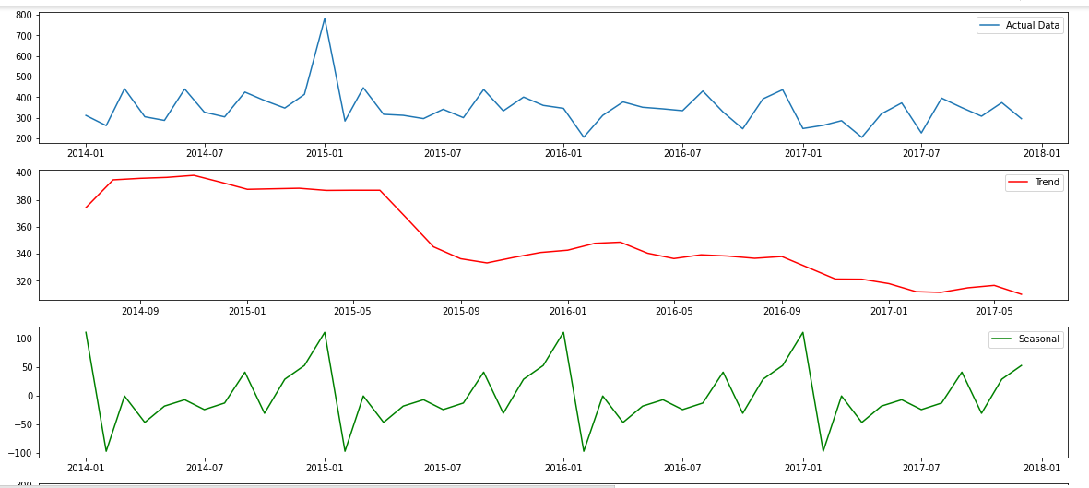
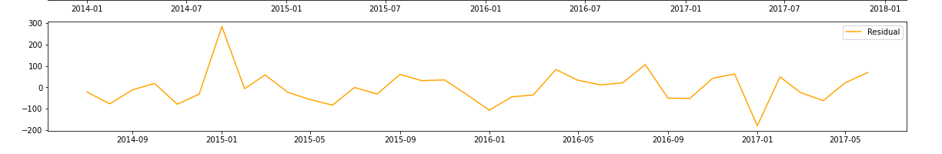
Visualizing Trend, Seasonal, Residual

Slide 6
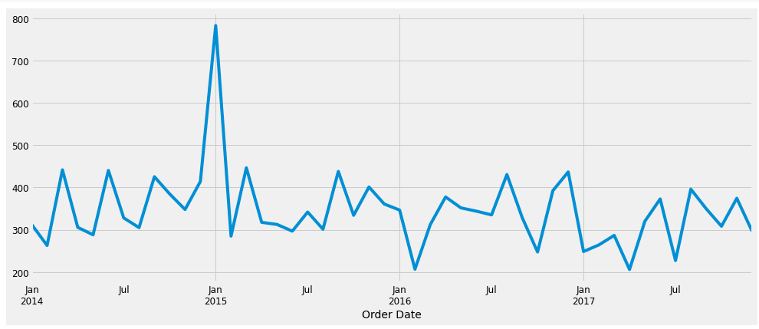
Analysis Of Sales Over The Years

Slide 7
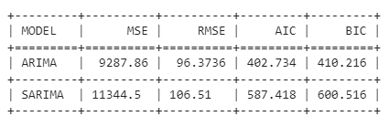
Performance Of Both The Models

Slide 8
Conclusion
Hence, ARIMA MODEL performed better in terms of all evaluation parameters performed by achieving lower results for MSE,RMSE,AIC and BIC than Sarima

